Slide 1
S7:Layer 3 Centric, L3VPN, Path Computation Element Server

Slide 2
1.Layer 3 Centric
Controllers supporting L3VPN overlays such as Juniper Networks Contrail Systems Controller, and L2VPN overlays such as Alcatel Lucent’s Nuage Controller are coming to market that promote a virtual Provider Edge (vPE) concept.
Provider Edge Router (vPE): The vPE is a virtualized edge router within the provider's network. It interfaces with the customer's CE router and handles the routing of data between the customer's network and the core provider network.
Provider Core Network: The core network managed by the provider, responsible for forwarding data packets to their destination across the provider's infrastructure
The virtualization of the PE function is an SDN application in its own right that creates both service or platform virtualization.

Slide 3
1.1.L3VPN
Layer 3 VPN (L3VPN) is a type of VPN mode that is built and delivered on OSI layer 3 networking technologies. The entire communication from the core VPN infrastructure is forwarded using layer 3 virtual routing and forwarding techniques.
Layer 3 VPN is also known as virtual private routed network (VPRN).
The idea behind these offerings is that a virtual routing and forwarding (VRF) structure can represent a tenant and that the traditional tooling for L3VPNs can be used to create overlays that use MPLS labels for the customer separation on the host, service elements, and data center gateways.
.
https://www.youtube.com/watch?v=ryzgNpFFENI&t=153s

Slide 4
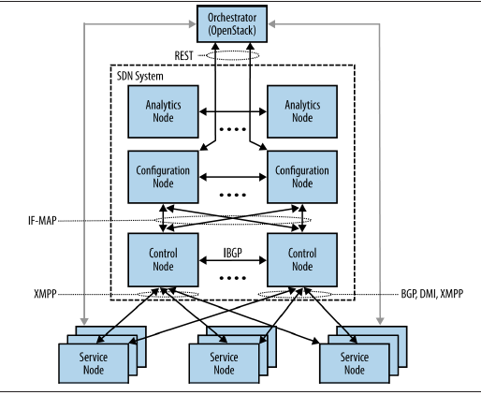
1.2.Juniper Networks Virtual Network System SDN controller system
The Juniper approach involves a high-level data model that self-generates and presents a REST API to SDN applications such as the one shown in Figure
a data center orchestration application that can be used to provision virtual routers on hosts to bind together the overlay instances across the network underlay.
The system supports potentially separable modules that can operate as individual virtual machines in order to handle scale out server modules for analytics, configuration, and control.

Slide 5
1.2.1.COMPONENTS
Analytics: Provides the query interface and storage interface for statistics/counter reporting
Configuration
Provides the compiler that uses the high-level data model to convert API requests for network actions into low-level data model for implementation via the control code
Control
The BGP speaker for horizontal scale distribution between controllers (or administrative domains) and the implementer of the low-level data model (L3VPN network primitives distributed via Extensible Messaging and Presence Protocol(XMPP) commands—VRFs, routes, policies/filters).

Slide 6
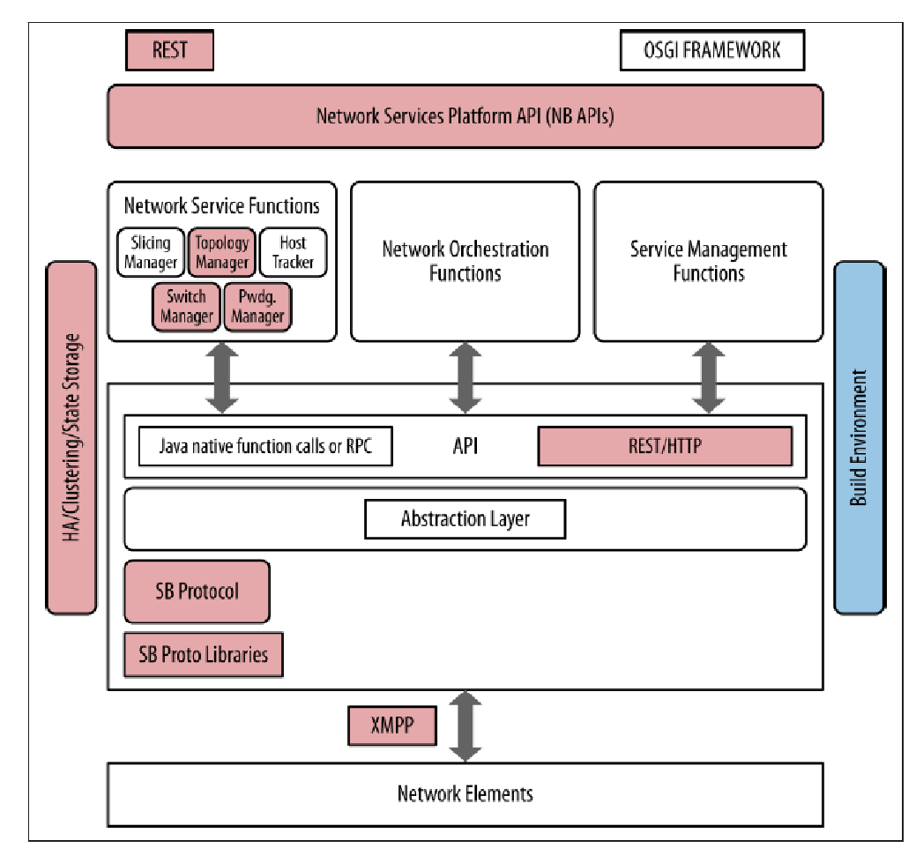
1.3.Relationship to the idealized SDN framework
Contrail VNS capabilities (against an idealized controller framework)
Figure maps the relationship of the Juniper Contrail Controller’s components to the idealized SDN framework, with the areas highlighted that the controller implements.
In this case, the platform implements a RESTful northbound API that applications and orchestrators can program to, including the OpenStack API integration.
In terms of the southbound protocols, we mentioned that XMPP was used as a carrier channel between the controller and virtual routers, but additional south bound protocols such as BGP are implemented as well.

Slide 7
2.Path Computation Element Server
Multiprotocol Label Switching (MPLS) is a label switching technology that provides the ability to set up connection-oriented paths over a connectionless IP network.
The Path Computation Element (PCE) is a network component, application, or node that is capable of computing network paths or routes based on a network graph and various constraints. The PCE can be centralized, distributed, or hierarchical in nature. The server implementation of a PCE is often referred to as a Path Computation Element Server (PCE Server or PCEs)
2.1.RSVP-TE problem statement: Resource Reservation Protocol for Traffic Engineering
With traffic engineering, network traffic is routed efficiently to maximize throughput and minimize delay. Traffic engineering facilitates traffic flows to be mapped to the destination through a less-congested path than the one selected by the SPF algorithm.

Slide 8
2.2.The Path Computation Element (PCE) Solution
The Path computation element (PCE) server provides a comprehensive architecture for network path computation, aimed at optimizing the routing and traffic engineering in large-scale networks
There are multiple components of the PCE environment: a PCE server, a PCE client (PCC), and the PCE Protocol that is the protocol for data exchange between the PCE server and PCC.
Path Computation Client (PCC):
PCCs are network elements or applications that request path computations from the PCE. They send Path Computation Requests (PCReq) and receive Path Computation Replies (PCRep).
Path Computation Element (PCE):
The PCE is a dedicated server or application responsible for computing optimal network paths based on various constraints (e.g., bandwidth, latency, policy). It maintains a view of the network topology and resources.

Slide 9
PCE server services
The PCE server provides three fundamental services: path computation, state maintenance, and infrastructure and protocol support.
The PCE server uses the PCE Protocol in order to convey this information to network elements or PCCs. Ideally, the PCE server is a consumer of active topology.
Application-Layer Traffic Optimization (ALTO) protocol provides network information that applications use for modifying network resource consumption patterns while improving their performance.

Slide 10
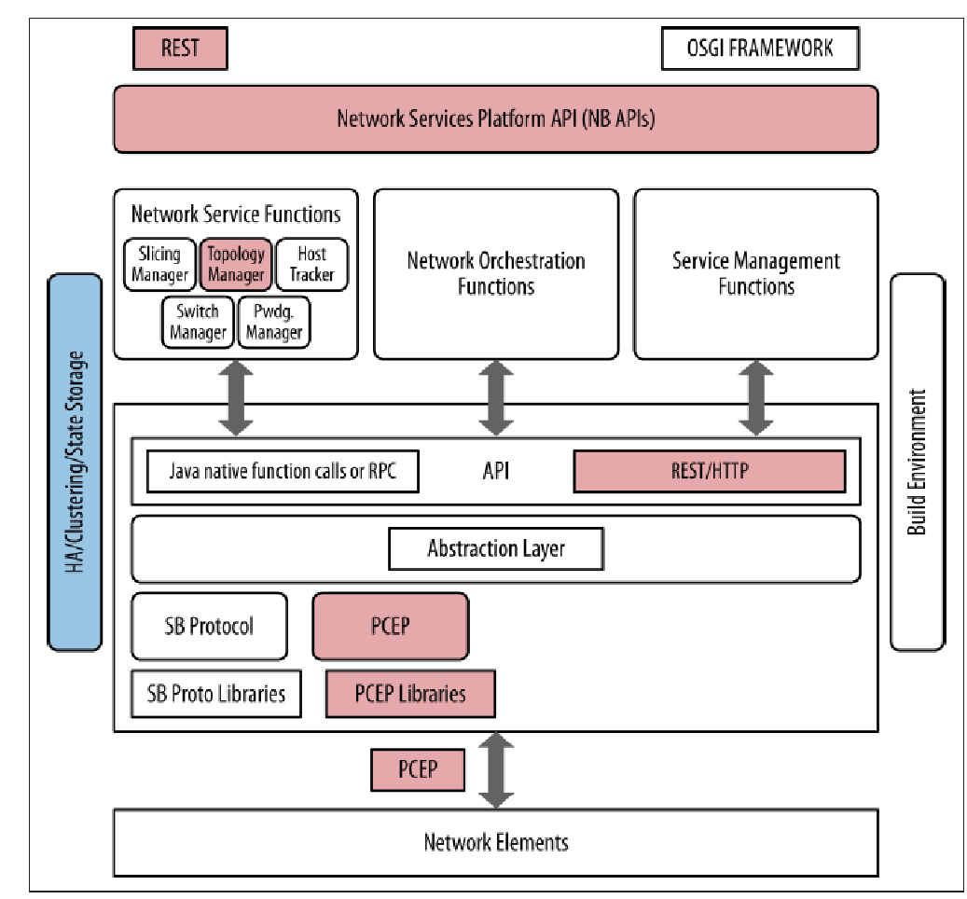
Relationship to the idealized SDN framework
PCE server capabilities (against an idealized controller/framework)
provides a RESTful northbound API offering a myriad of programmability options but generally only interfaces using a single southbound protocol (PCE-P).
It is for this reason that we generally view the PCE controller as being an adjunct to existing controllers, which can potentially expand that base functionality greatly.

Slide 11
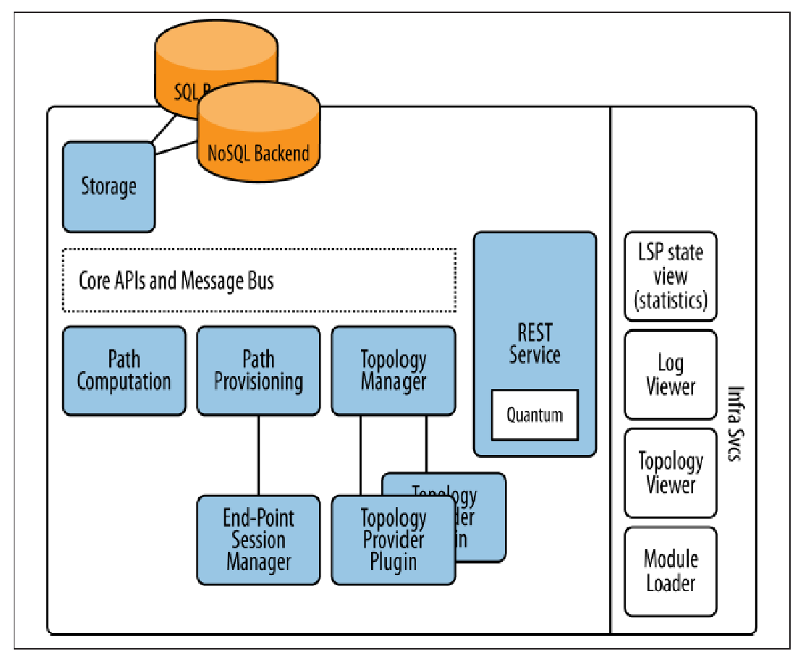
PCE server components (non -exhaustive/conceptual)
The other components in this controller solution would be typical of an SDN controller and would include infrastructure for state management, visualization, component management, and a RESTful API for application interface, as shown in Figure

Slide 12
S8:Plexxi Plexxi Affinity

Slide 13
Plexxi
Plexxi Systems are based around the concept of affinity networking, ("Affinity networking" typically refers to a networking strategy where individuals connect and build relationships based on shared interests, backgrounds, or experiences. ) offering a slightly different kind of controller—a tightly coupled exclusive forwarding optimization algorithm and distribution system.
The Plexxi controller’s primary function is to gather information about affinities dynamically from external systems or statically via manually created policies and then translate this affinity information into forwarding topologies within the Plexxi network

Slide 14
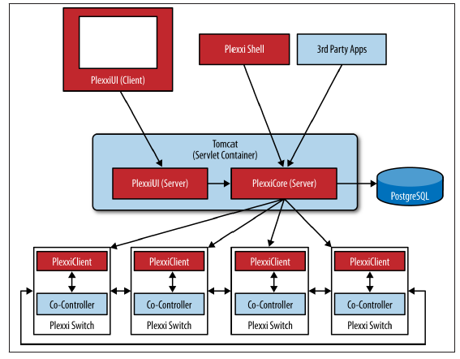
Plexxi Systems architecture
The Plexxi physical topology is ring based, and affinities are matched to ring identifiers, thus forming a tight bond between the overlay and underlay concepts.
The controller tasks are split between a controller and co-controller, where the central controller maintains central policy and performs administrative and the algorithmic fitting tasks, while the co-controller performs local forwarding table maintenance and fast repair
In addition to learning about and creating affinities, the controller provides interfaces for operational and maintenance tasks. These interfaces include a REST API, a Jython shell, and a GUI.

Slide 15
The Plexxi topology and forwarding programming are part of a proprietary control protocol (PSCP).
The Plexxi control paradigm currently works only with Plexxi’s LightRail optical switches.
Plexxi scale is up to 250 switches per ring per controller pair..

Slide 16
Plexxi Affinity
An affinity consists of one or two affinity groups and an affinity link between them.
An affinity group is a collection of endpoints, identified by MAC or IP address.
An affinity link is a policy construct describing a desired forwarding behavior between two affinity groups or the forwarding behavior between endpoints within a single affinity group.
For instance, affinity group A can be a set of MAC addresses belonging to storage cluster members. Affinity group B can be a pair of redundant storage controllers

Slide 17
S9 :Cisco OnePK, Relationship to the Idealized SDN Framework

Slide 18
Cisco OnePK
Cisco OnePK (One Platform Kit) was a software development kit introduced by Cisco Systems aimed at enabling developers to build applications that interact directly with Cisco routers and switches. The concept revolves around providing an open, programmable interface to Cisco's networking devices, allowing for greater customization, automation, and integration of network management tasks.
The Cisco OnePK controller is a commercial controller that represents the framework concept by integrating multiple southbound protocol plug-ins, including an unusual southbound protocol plug-in, the Cisco OnePK API.
The architecture is a Java-based Open Service Gateway Initiative(OSGI) framework that uses an in-memory state storage model and provides a bidirectional (authenticated) REST interface.

Slide 19
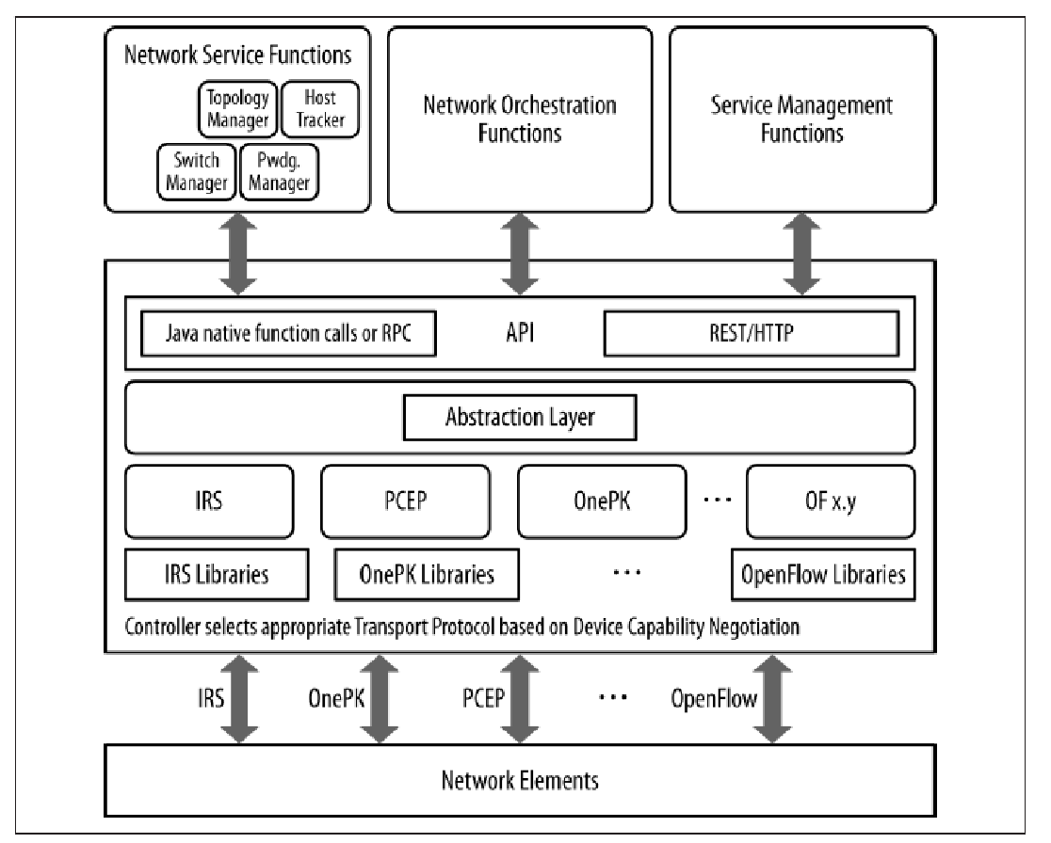
Cisco OnePK controller concept
controller logic is capable of reconciling overlapping forwarding decisions from multiple applications and a service abstraction that allows troubleshooting as well as capability discovery and mapping.
While it’s not unusual for the major network equipment vendors to offer their customers an SDK (a vendor-specific, network element programmability option that pre-dates SDN), the Cisco controller implements this as a plug-in in the generalized framework concept.
This opens the door to the continued use of their SDK in an SDN solutions environment (e.g., blending the OnePK API with OpenFlow) in places where the SDK (or SDK apps on the controller) can add value.

Slide 20
Relationship to the Idealized SDN Framework
It contains all aspects of the idealized controller in that it provides an extensible RESTful API, an integrated development environment, multiple computational engines, as well as different southbound protocols
The controller contains capabilities for both memory resident and offline, and distributed state management and configuration storage. It also contains provisions for horizontal controller-to-controller communication and coordination.
Finally, the controller implements an abstraction layer that facilitates the many-to many communication channels needed to program such a controller.

